Slide 1
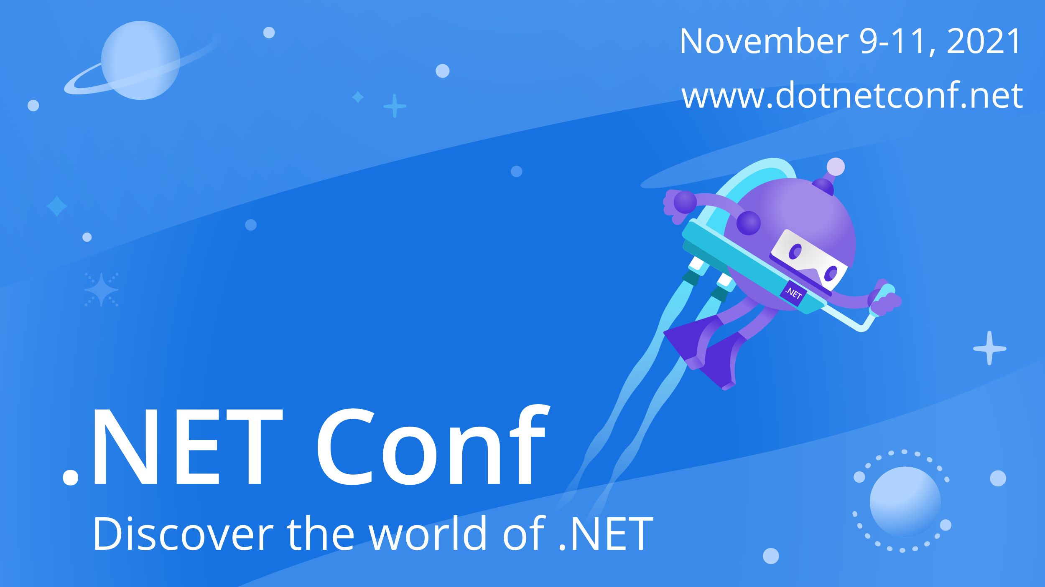

Slide 2


A primer on FeatureManagement APIs in .NET Core
Santosh Hari @_s_hari

Slide 3
Session learning objective
At the end of this session, you will be better able to understand the power of FeatureManagement with use cases, best practices and how your development team can leverage it to deliver features with agility while mitigating risk

Slide 4
Agenda
Basics of Feature Flags
Strategies
FeatureManagement
DEMO
Lessons learned
Notes:
In today’s talk we’ll focus on Feature Flags.
I will tell you about feature flags, what are they and what they look like and use cases
Then we’ll talk about the difference between deployments and release
Then we get into the meat of the talk with discussion on Toggles, A/B Testing and Canary releases
I will then touch on some useful feature flag frameworks and services that enable them
I will then end with some tech considerations – pros, cons, best practices and gotchas while using feature flags
This is a,broad high level talk on all these concepts, frameworks and tools
I will leave you with resources to do deep dives

Slide 5
Speaker Info
Santosh Hari
Sr Consultant @ Microsoft
Organizer @ Orlando .NET User Group and Orlando Codecamp
Twitter: @_s_hari
LinkedIn: /in/santoshhari
Content and Code
github.com/desinole/feature-flags

Slide 6
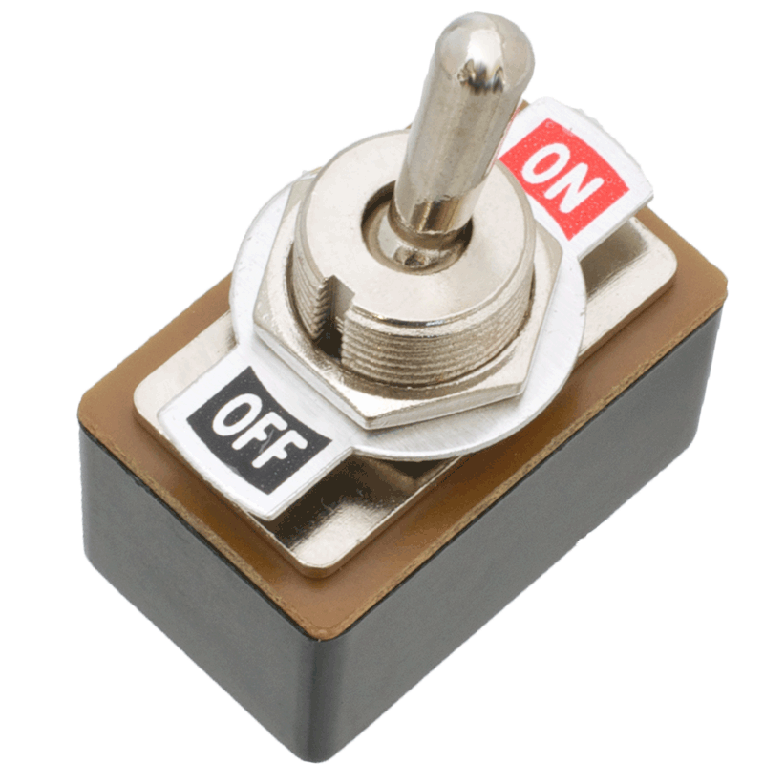
Feature Flags
Feature Toggles (often also referred to as Feature Flags) are a powerful technique, allowing teams to modify system behavior without changing code.
This Photo by Unknown Author is licensed under CC BY-SA
Notes:
In software, a flag is "one or more bits used to store binary values"
aka a Boolean that can either be true or false.
In the same context in software, a feature is a chunk of functionality that delivers some kind of value.
Thus, a feature flag, in the simplest terms, is an IF statement surrounding some chunk of functionality in your software.
Feature flags, in reality, can be and are more complex than that.
A feature flag is a way to change your software’s functionality without changing and re-deploying your code.
Feature Flags, also referred to as "Feature Toggles" is a set of patterns which can help a team to deliver new functionality to users rapidly but safely.

Slide 7
Feature Flags are “if” statements
if(enableFeature(trialperiodfeature, {start date, number of days}))
then
/*show the trial period feature */
else
/* show the old feature
enabledFeature = toggle configuration
trialperiodfeature = toggle router
{start date, number of days} = toggle context
Notes:
In simple terms, a feature flag is a decision point in your code
That changes the behavior of your application.
Feature flags—also known as feature toggles—have long been used
to trigger “hidden” code or behaviors without having to ship new versions of your software.
In ancient ASP.NET web app days we put flags in web.config file and changed them occasionally
enabledFeature = toggle configuration (determines if we should even use the feature flag
trialperiodfeature = toggle router (method that calculates if feature flag should be triggered)
{start date, number of days} = toggle context (conditions under which the feature flag is triggered)

Slide 8
Deployment versus Releases
Installed on prod
Not exposed to customers
Minimal impact
Technical decision
Receiving prod traffic
Exposed to customers
High impact
Business decision
Deployment –
All Changes
Release - Changes visible to customer
Notes:
When we use the term "Deployment"
we're talking about your team’s process for installing the new version of your code on production.
When we say a new version of software is deployed,
we mean it is running somewhere in your production infrastructure.
Deployment does not mean customers have access to this new version.
Deployments are low risk because even when new code fails
Deployments should have minimal impact on the customer.
Deployments should be driven by software teams
When we say a new feature is released, this means that production traffic is hitting the code for this new feature.
In our example the trial feature experiment was only turned on when the flag was enabled
When production traffic hits this new code, all the risks associated with releases
– outages, crashes, performance issues, bugs - are exposed to customers.
The decision to release new features could involve various stakeholders including non-software team members.
Takeaway:
Deployments should be continuous and low impact to customer
Release should be a mindful business decision and should be high impact to the customer (hopefully positive)
And this separation between release and deployment is accomplished with feature flags

Slide 9
Feature Flags Strategies
Toggle/Kill switches
A/B
Canary
Rings
Blue-green

Slide 10
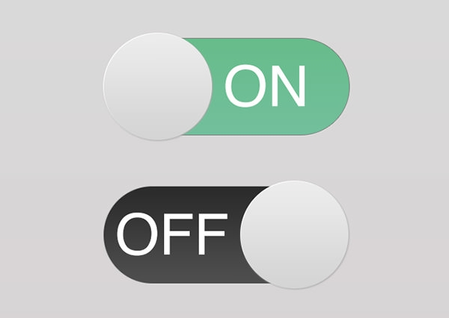
Toggle/Kill switches
ON/OFF
All or nothing
Types
Always ON/OFF
Date/Time based
Randomizer ON/OFF
Kill Switch
This Photo by Unknown Author is licensed under CC BY-SA
Notes:
In simplest terms, a toggle is a ON/OFF button.
You can basically turn a feature on and off with a toggle by redirecting code flow in production.
A well-wrapped feature means you can quickly turn it off if it’s performing poorly.
This can be the difference between a public relations disaster and minimal impact.
AlwaysOffFeatureToggle
AlwaysOnFeatureToggle
EnabledOnOrAfterDateFeatureToggle
EnabledOnOrBeforeDateFeatureToggle
EnabledBetweenDatesFeatureToggle
SimpleFeatureToggle
RandomFeatureToggle (from v2.1)
EnabledOnDaysOfWeekFeatureToggle (from v2.1)
Ability to turn changes off if something goes wrong

Slide 11
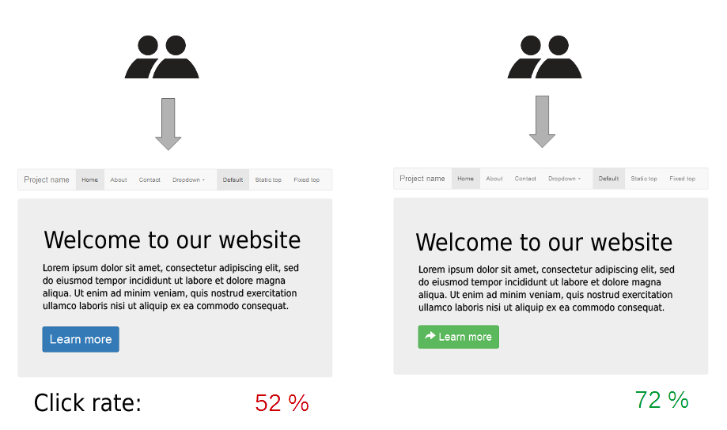
A/B
Binary choice: Either/Or
Percentage-based rollouts
Experimentation
User Feedback
Notes:
Similar to a toggle but it’s not all or nothing
A/B testing (also known as split testing) is a process of showing two variants of the feature
to different segments of customers at the same time and comparing which variant drives more conversions. the variant that gives higher conversions is the winning one
allow you to serve multiple variations of a feature to different user segments
Easier to gather user feedback

Slide 12
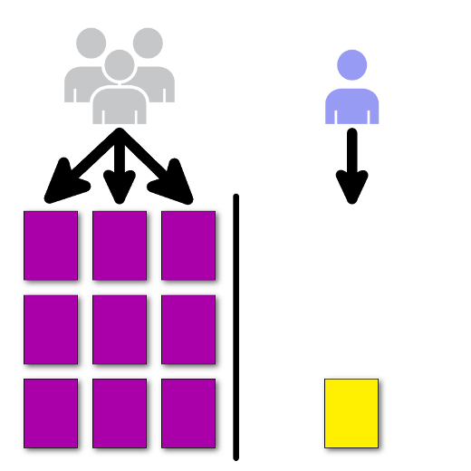
Canary
Small targeted percentage of users
Employed separately or with other approaches
Easy to rollback
Maintain multiple versions of code
Notes:
Story of a canary in a coalmine – when it stopped singing get the heck out
When you are happy with the new version, you can start routing a few targeted users to it.
This small set of target users are the canary
As new version proves itself, rollout to more users
Migrate phase could last for weeks
Phased rollout helps smooth out new version – bugs, performance, functionality, etc
Easy to rollback
Downside? Manage multiple versions

Slide 13
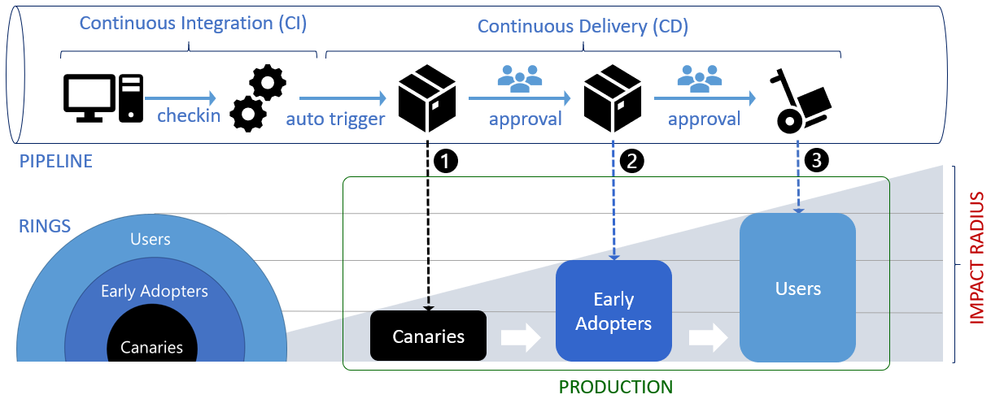
Rings
Popularized by Microsoft
Rollout by groups – small to large
Canary group
Insiders/Early Adopters
All
Limit blast radius
Maintain multiple versions of code
This Photo by Unknown Author is licensed under CC BY-SA
Notes:
Ring deployments, a term coined by Microsoft,
is another method to gradually expose features to different groups of users.
groups are selected specifically to manage the risk of deployment.
start with small groups of low-risk users
expand through larger, higher-risk populations.
It goes something like this
Canary groups
Insiders/Early Adopters
All
This helps identify problems early while limiting the “blast radius” of disruption if something goes wrong.
Downside is that you may have to maintain multiple versions of the codebase
Worst case one for each ring

Slide 14
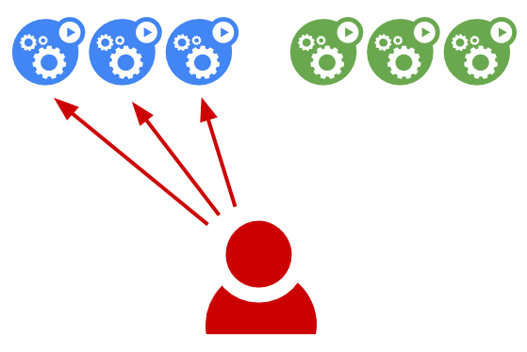
Blue-Green
Blue == current
Green == new
Green high risk profile
Beyond scope
This Photo by Unknown Author is licensed under CC BY
Notes:
blue-green deployments is an useful concept to discuss
since it involves separating deployments from releases.
But it’s Overkill for simple code changes, better suited for infrastructure
Blue-green deployments can be used instead of or with Feature Flags.
Green (new) version is deployed to fresh set of machines or containers
but since it's not yet exposed to production it's considered "Not released".
Blue (current) version is running on currently dedicated prod infrastructure
Release in a blue-green setup usually involves making changes at the load balancer
to redirect production traffic from the blue (current) machines to the green (new) machines.
The operation equates to add hosts running the new version and remove hosts running the known-good version.
Blue-green deployment involve infrastructure level changes.
Once switched over new changes have same high risk profile.
These deployments are easy to rollback.
>**Note:** Since blue-green deployments often involve production infrastructure,
this might be an useful technique to use when infrastructure level changes occur.
Feature Flags could still handle code level changes.

Slide 15
FeatureManagement in .NET Core
C# and .NET Developers
Build on .NET Core IConfiguration
Toggle with config files
API extensions ASP.NET Core and MVC
Name + Feature Filter
Standalone
Notes:
FeatureManagement provide comprehensive feature flag support in .NET Core
These libraries are built on top of the .NET Core configuration system.
- Supports local JSON file feature flag setup
- Configuration values can change in real-time, feature flags can be consistent across the entire request
- Toggle on/off features through declarative configuration file
- Dynamically evaluate state of feature based on call to server
- API extensions for ASP.NET Core and MVC framework: Routing, Filters and Action Attributes
Feature Flags consists of a name and a feature filter.
Feature Filters are scenarios for enabling/disabling flags.
For instance, a filter that enables the flag for only 10% of the requests.
Downside: Config file approach is Standalone toggle for applications

Slide 16
App Configuration
Azure PaaS
Central toggle
Manage app settings and feature flags
Feature Flags auto update
Easy to setup and manage flags
Security (MSI, encryption – REST + transit)
Key Vault integration (app settings)
IaC friendly
Multiple SDKs
Notes:
App Configuration provides Azure PaaS to centrally manage application settings and feature flags.
You can create an end-to-end implementation of feature management in an ASP.NET Core application
using Azure App Configuration using the App Configuration service to centrally store all your feature flags and control their states.
feature flags are automatically updated without redeploying your app
the .NET Core SDK automatically pulls feature flags every 30 seconds by default)
A fully managed service that can be set up in minutes
Flexible key representations and mappings
Tagging with labels
Dedicated UI for feature flag management
Comparison of two sets of configurations on custom-defined dimensions
Enhanced security through Azure-managed identities
Encryption of sensitive information at rest and in transit
IaC friendly with ARM templates and Terraform like any other azure service
Native integration with popular frameworks

Slide 17
Demo
Notes:
Ring Release with FeatureManagent in Console App
FeatureManagement + Azure App Config

Slide 18
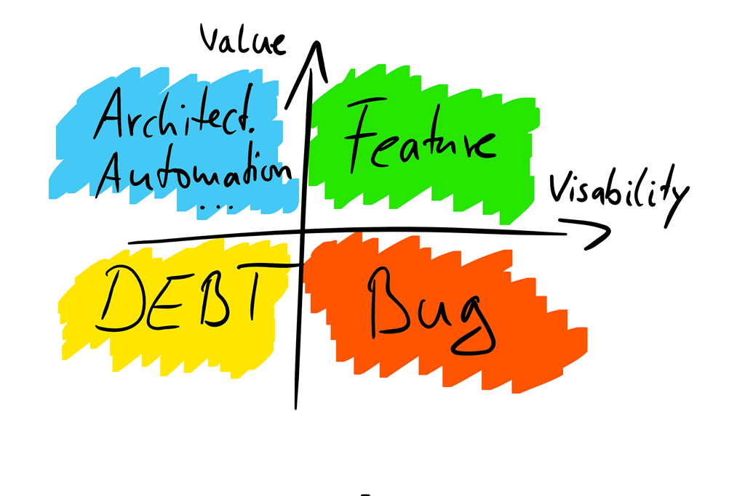
Feature Flags are technical debt
Periodic Review
Remove stale ones
Remove after final release
Plan for permanent flags
This Photo by Unknown Author is licensed under CC BY
Notes:
Feature flags is essentially new code you're adding which means they should be treated as technical debt.
You need to have a review process in place to periodically review all feature flags.
Older flags with deprecated or unused features should be removed ASAP.
If a feature is released to all users, the feature flag is no longer needed, ie, should be removed.
Permanent feature flags, for instance,
ones used to handle subscription type access should be reviewed
and maintained for as long as they're in use.

Slide 19

Daisy-Chaining Feature Flags
Feature flags dependent on each other
Leads to unpredictable behavior
Small batches principle
This Photo by Unknown Author is licensed under CC BY-SA
Notes:
In electrical and electronic engineering, a daisy chain is a wiring scheme
in which multiple devices are wired together in sequence or in a ring
Combining multiple feature flags could lead to multiple features being toggled on or off simultaneously
which could lead to unpredictable system behavior
including increased system load, decrease in system performance and crashes.
Using DevOps principle of small batches,
limit the number of Feature Flags you're enabling or disabling at the same time.
Microsoft has the story in 2013 when they did a TFS release and flipped all feature flags on at once

Slide 20

Change Advisory Boards (CABs)
Leverage feature flags to tackle bureaucracy
Deploy code without invoking it
Last step: add feature flag and turn on
Have a plan
Dedicated maintainer
Expiry dates
Naming convention
This Photo by Unknown Author is licensed under CC BY-NC-ND
Notes:
A change-advisory board ("CAB") delivers support to a change-management team by advising on requested changes,
assisting in the assessment and prioritization of changes.
This body is generally made up of IT and Business representatives that include:
a change manager, user managers and groups, technical experts and, possible third parties and customers (if required).
Their primary goal is to reduce risk when code is deployed Since the CAB members are largely concerned with changes impacting customer,
you could add code that does not hit any production paths (think: 0 code references in C#)
over a period of time and continue pushing the code to deployment.
When time comes for a CAB review, you can simply add a Feature Flag and send it for review.
An additional advantage of this approach is that most,
CAB members are concerned about rollback in case the code is not working and feature flags can handle this situation with ease.
These days CABs have become more savvy and will point out that feature flags are tech debt
Plans:
Appoint a maintainer – usually the person who added the flag
Expiry date – for instance, we know how long the A/B test will run for
Having a naming convention to make them easy to find

Slide 21

Measure Everything
Establish a baseline
Progressively roll out changes using Feature Flags
Measure impact of each change using Feature Flag as reference
Be intellectually honest about positive/negative impact
This Photo by Unknown Author is licensed under CC BY-SA
Notes:
Every change you make to your software is an experiment,
even if you don’t explicitly design them as such.
When you release a new change using a feature flag,
you have a built-in capability to measure the impact of the change. You begin by establishing important baselines for your product, such as the number of signups, dollars in sales, or searches performed.
Then, as you progressively roll out, compare user activity in the old cohort
with the behavior in the new one to ensure you are affecting your baseline metrics positively.
Isn’t always easy to predict the way users will react to changes
Measuring your new features against existing baselines helps to reduce the risk of change

Slide 22

Use Frameworks
Focus on solving business problems
Well tested and maintained frameworks
This Photo by Unknown Author is licensed under CC BY-SA
Notes:
As we discussed earlier, feature flags are additional code you add to your system.
This means additional maintenance.
The purpose of feature flags is to control exposure of features to the customers
aka separating deployments from releases.
Since feature flags are largely used to achieve team/process/business goals,
Unless you’re using permanent feature flags like for subscription
they're not central to solving your actual business problems.
Do not spend time writing your own implementation unless absolutely necessary.
Use mature frameworks that we discussed in earlier sections.

Slide 23
Branching strategies
No long lived feature branches
“Many software development teams are used to developing features on branches for days or even weeks. Integrating all these branches requires significant time and rework. Following our principle of working in small batches and building quality in, high-performing teams keep branches short-lived (less than one day’s work) and integrate them into trunk/ master frequently.”
— Accelerate: The Science of Lean Software and DevOps: Building and Scaling High Performing Technology Organizations by Nicole Forsgren PhD, Jez Humble, et al.
Notes:
Works with any trunk/main-based branching strategy
Strongly recommend short lived feature branches
This is a quote from Accelerate
With feature flags, the release of software to users becomes a business decision instead of a technical decision.
The execution of a section of code or feature no longer needs a dedicated source code branch,
but becomes an execution branch instead, controlled by the feature flag.

Slide 24
Speaker Info
Santosh Hari
Sr Consultant @ Microsoft
Organizer Orlando .NET User Group and Orlando Codecamp
Twitter: @_s_hari
LinkedIn: /in/santoshhari
Content and Code
github.com/desinole/feature-flags

Slide 25

Thanks for joining!

